Slide 1

School of Computer Science and AI, SR University
Course Code | Course Title | L | R | P | Cr
25CAI004PC206 | AI Assisted Coding | 0 | 0 | 4 | 2
Program Core
Overview – AI Assisted Coding
Lecture - 1
1. Manual Coding Vs. AI Assisted Coding
2. AI-assisted coding Tasks
3. Types of AI-assisted coding tools
4. The working mechanism of an AI-assisted coding tool
5. AI-assisted coding tools + Generative AI models 6. Benefits, Challenges and Limitations
Dr. Venkataramana Veeramsetty
Professor

Slide 2
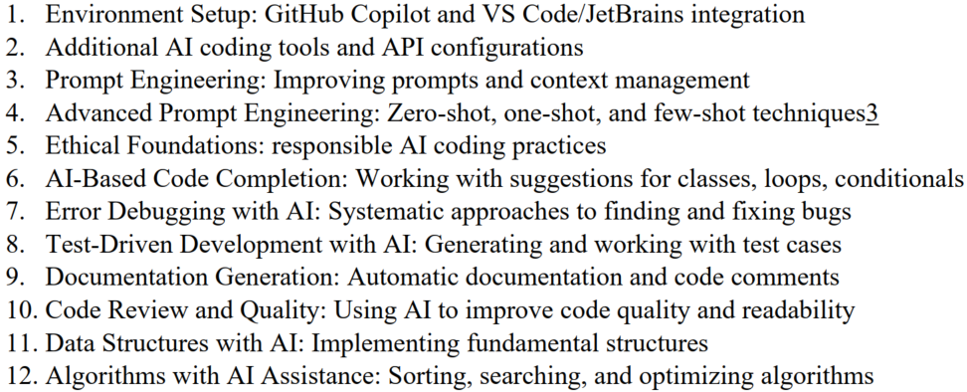
Syllabus [List of the Experiment]
Slide Title

Slide 3
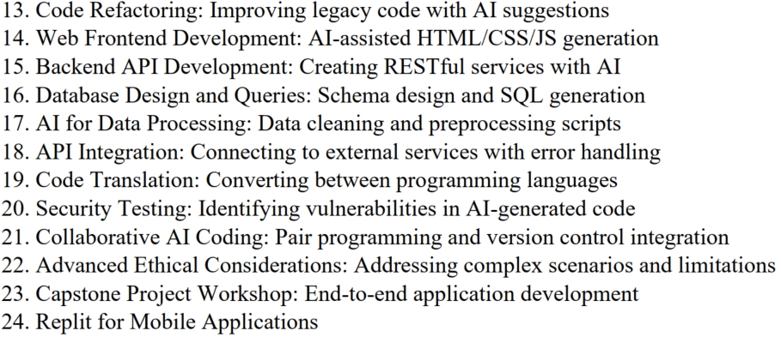
Syllabus [List of the Experiment]

Slide 4
Syllabus [List of the Experiment]

Slide 5
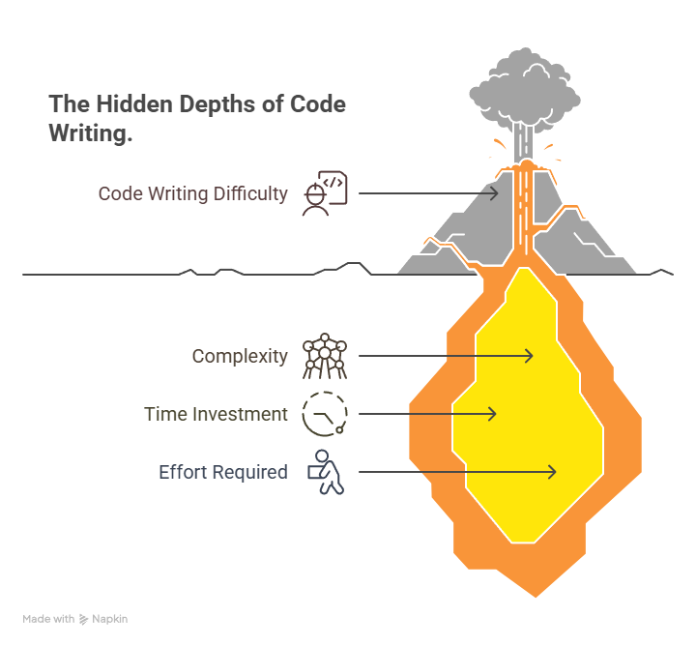
Slide Title
Manual coding
Writing code by hand is an important but often difficult task. It can be complex and takes a lot of time and effort from developers.
Notes:
The algorithms powering these tools are trained on vast amounts of existing source code, typically from publicly available open-source projects. Based on these examples, the algorithms can generate custom code on demand, via text prompts.

Slide 6
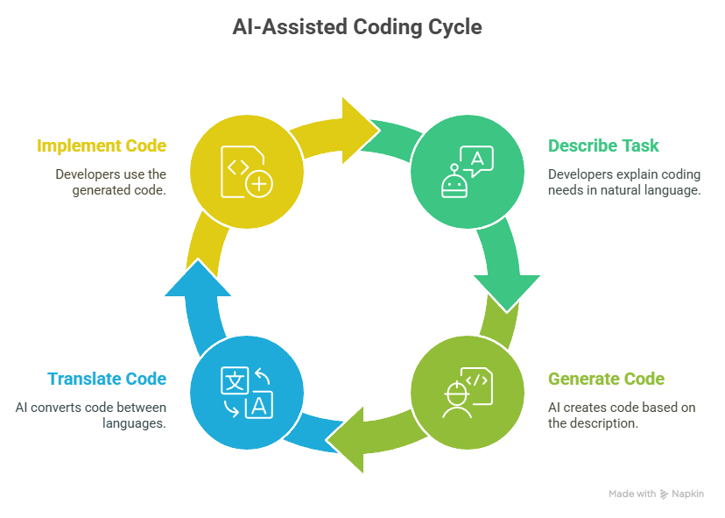
Slide Title
AI Assisted Coding
AI-assisted coding uses artificial intelligence and advanced machine learning to help generate code automatically
AI Assisted Coding tools allow developers to describe in text format what they want their code to do and then tool generate the code to accomplish that task.
Notes:
AI-assisted coding uses artificial intelligence and advanced machine learning to help generate code automatically
These tools allow developers to describe in English or other native language what they want their code to do and then have the tool generate the code to accomplish that task.
This includes the creation of common elements such as custom variable names and the calling of external modules or services.
AI code tools can also translate code from one language to another

Slide 7
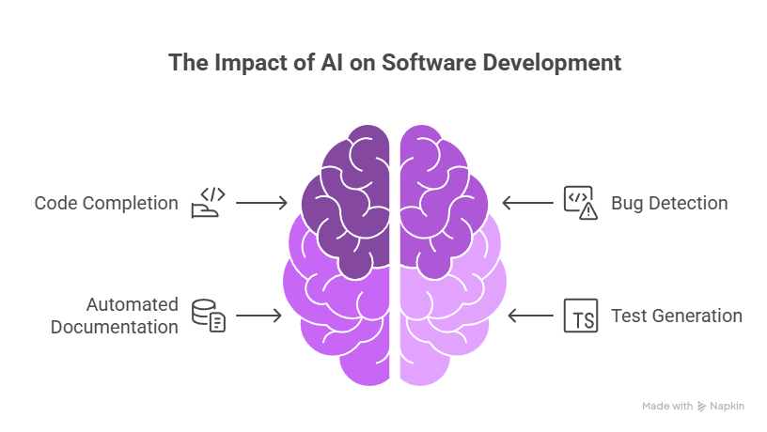
Slide Title
Impact of AI Assisted Coding in Software Development
The algorithms powering these AI Assisted Coding tools are trained on vast amounts of existing source code, typically from publicly available open-source projects.
Based on these examples, the algorithms can generate custom code on demand, via text prompts.
Notes:
Artificial Intelligence (AI) is revolutionizing the way software is developed. AI-Assisted Coding is the integration of intelligent tools and models into the software development lifecycle to improve code quality, enhance productivity, and reduce development time. From code completion and bug detection to automated documentation and test generation, AI tools are becoming indispensable assets for developers.
This course aims to introduce learners to the evolving landscape of AI in coding, explore various tools and platforms, and understand both the potential and boundaries of this technological shift.

Slide 8
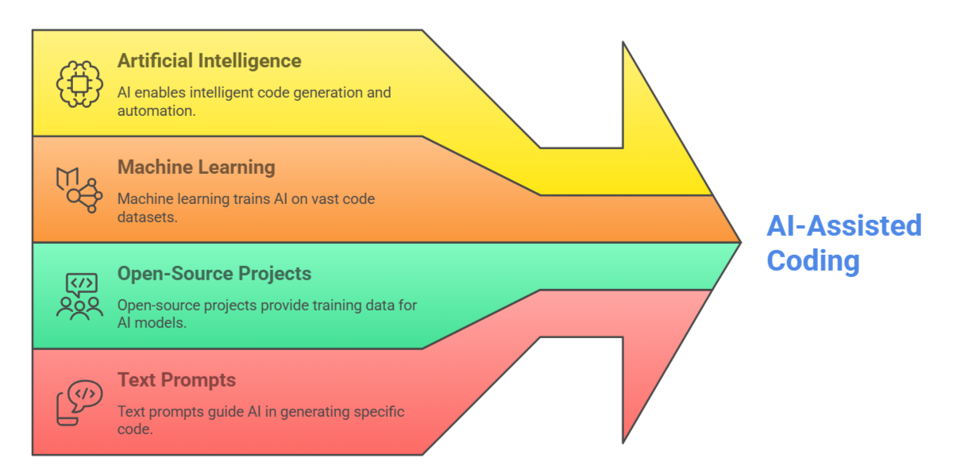
Slide Title
AI Tools Development Life Cycle
Notes:
AI-assisted coding uses artificial intelligence and advanced machine learning to help generate code automatically
The algorithms powering these AI Assisted Coding tools are trained on vast amounts of existing source code typically from publicly available open-source projects.
AI Assisted Coding tools generate the code based on text prompts

Slide 9
Slide Title
History of Automated Coding
Automatically generating source code is not new. Low-code and no-code development tools have been available for decades
AI-assisted code generation is different in that unlike low-code and no-code tools, it does not rely on pre-built code modules
AI-assisted coding tools generate custom code from scratch each time
AI-assisted coding employs Machine Learning (ML) models, primarily utilizing Natural Language Processing (NLP) to understand and interpret code.
The system is trained on large datasets comprising numerous examples of code, allowing it to learn the syntax, semantics, and patterns inherent in programming languages.
Common programming and coding languages supported by AI code assistants include Python, Java, JavaScript and Ruby. There are also AI tools that will generate code in PHP, C++ and C#

Slide 10
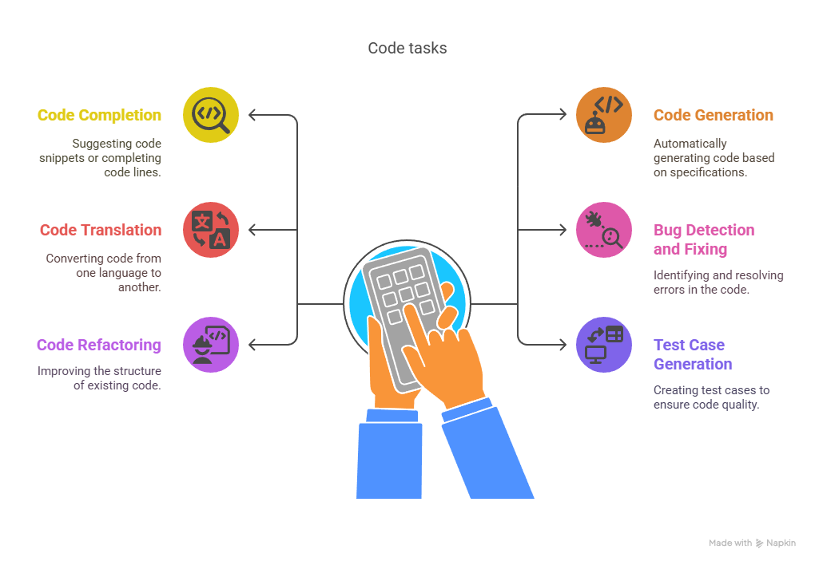
Slide Title
AI-assisted coding Tasks
Notes:
AI-Assisted Coding Tasks
Code Completion
Predicts and suggests the next line or block of code as you type.
Helps speed up development and reduce syntax errors.
Code Generation
Generates code from natural language descriptions or comments.
Converts high-level requirements into functioning code snippets.
Code Translation
Converts code from one programming language to another.
Useful for migrating projects or learning new languages.
Bug Detection and Fixing
Identifies potential bugs or errors in code.
Suggests fixes or automatically corrects them.
Code Refactoring
Improves code structure without changing its behavior.
Enhances readability, performance, and maintainability.
Test Case Generation
Automatically creates unit and integration tests for given functions or classes.
Ensures better test coverage and reliability.

Slide 11
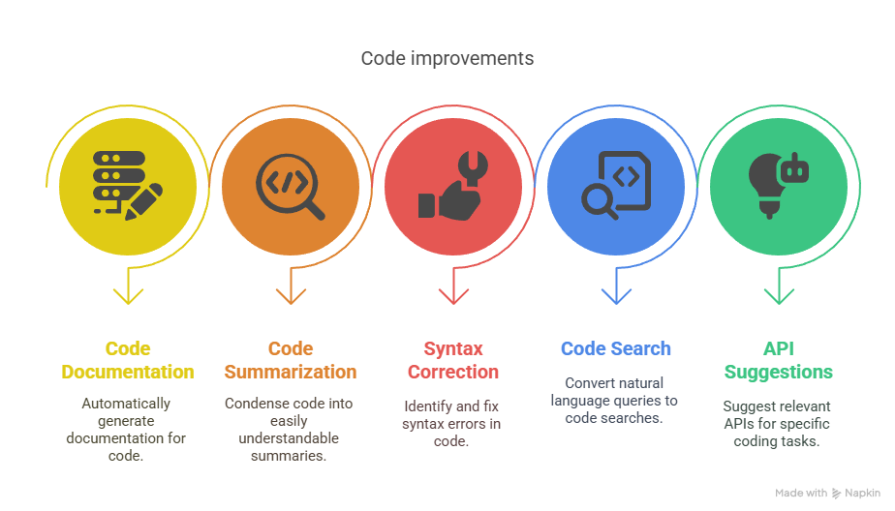
Slide Title
AI-assisted coding Tasks Cont.
Notes:
Code Documentation
Generates comments and documentation from the code.
Saves time and improves understanding for others reading the code.
Code Summarization
Provides a high-level summary or explanation of a code block.
Useful for learning or reviewing unfamiliar codebases.
Syntax and Style Correction
Enforces coding standards and formatting rules.
Corrects indentation, naming conventions, and style violations.
Natural Language Query to Code Search
Finds relevant code snippets or functions based on plain language queries.
Helps developers quickly locate needed components.
API Usage Suggestions
Recommends correct and efficient ways to use APIs or libraries.
Reduces the need to constantly refer to documentation.

Slide 12
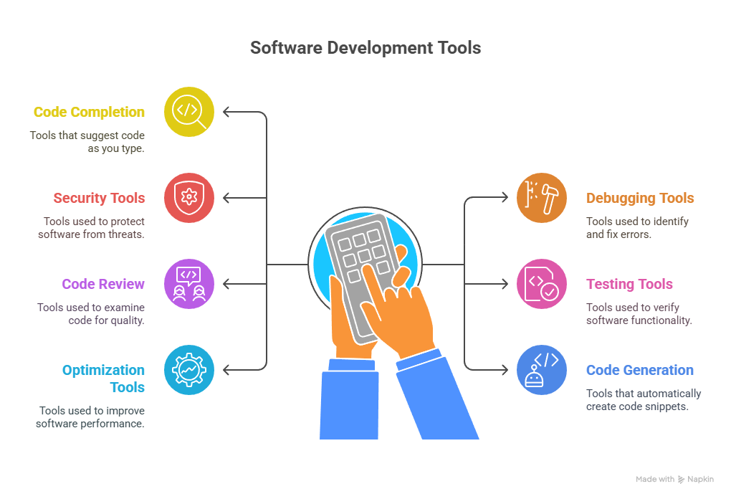
Slide Title
Types of AI-assisted coding tools
Notes:
Code completion tools
Debugging tools
Security tools
Testing Tools
Code Review tools
Code Generation tools
Optimization tools

Slide 13
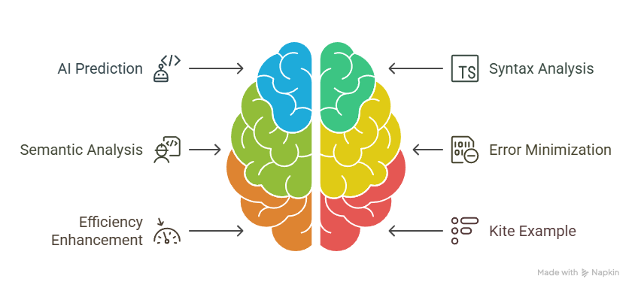
Slide Title
Code completion tools
Kite: A prominent example of a code completion tool, Kite offers intelligent code completions powered by machine learning and works with multiple programming languages.
Notes:
Code completion tools leverage AI to predict and suggest the next line or block of code a developer is likely to write based on the current context of the code being written. They analyze the syntax and semantics of the written code to provide relevant and accurate suggestions, minimizing the likelihood of errors and enhancing coding efficiency.

Slide 14
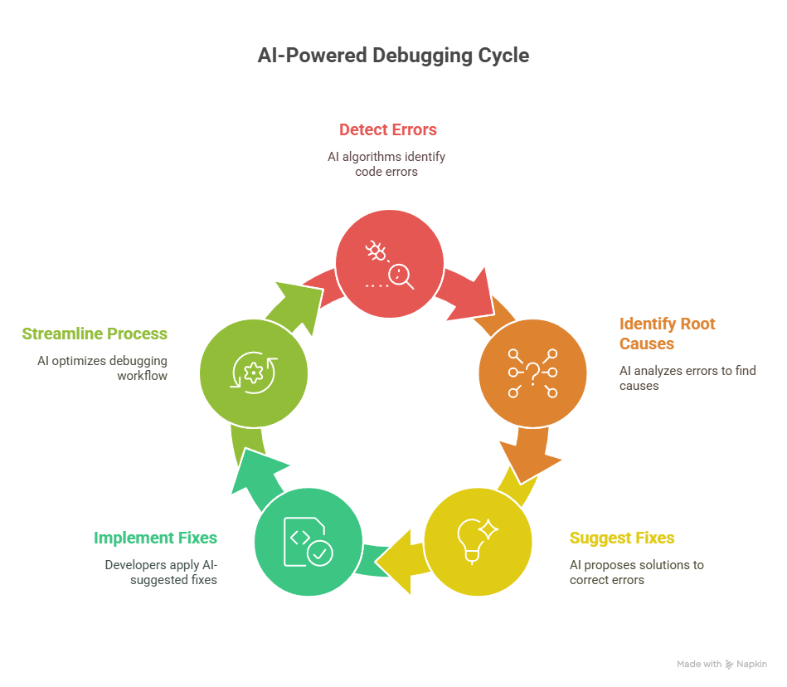

Slide Title
Debugging tools
https://www.rookout.com/
Notes:
AI-powered debugging tools utilize advanced algorithms to detect and correct errors in the code automatically. They streamline the debugging process by identifying the root causes of issues and suggesting appropriate fixes, reducing the time and effort developers need to spend on debugging.
Rookout: This tool allows developers to set non-breaking breakpoints and fetch the needed data without stopping the code or adding extra code lines, leveraging AI to streamline the debugging process.

Slide 15
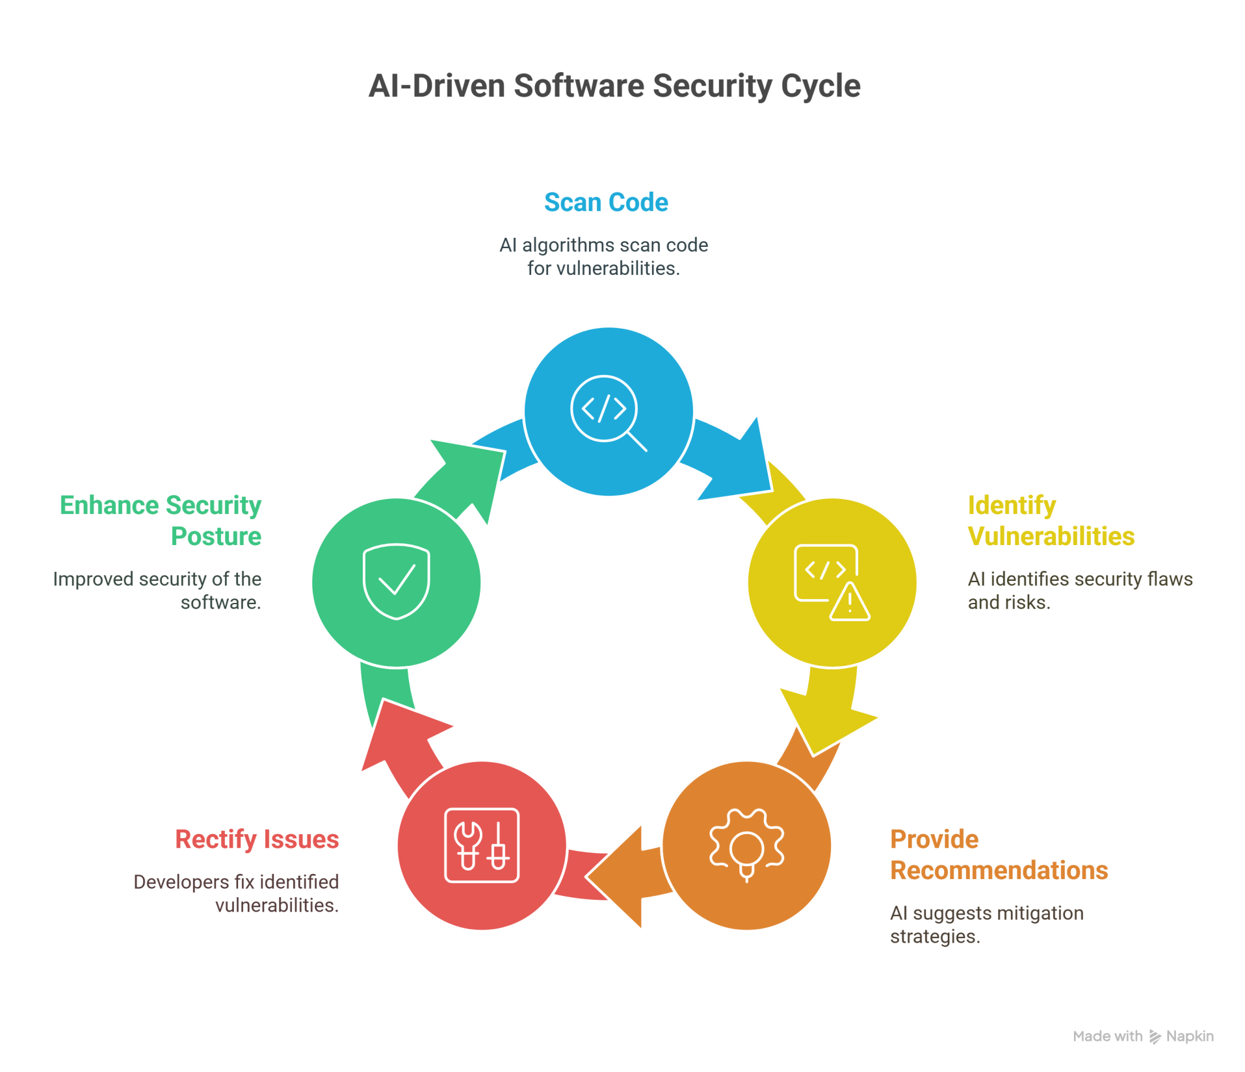

Slide Title
Security Tools
https://snyk.io/
Notes:
Security tools
Security tools empowered by AI algorithms scan the code to identify and rectify security vulnerabilities. They analyze the code against known security flaws and provide recommendations to mitigate the risks, thereby enhancing the security posture of the developed software.
Snyk: A security tool that leverages AI to identify and fix vulnerabilities and license violations in open-source dependencies, ensuring the security of the code from the development phase.

Slide 16
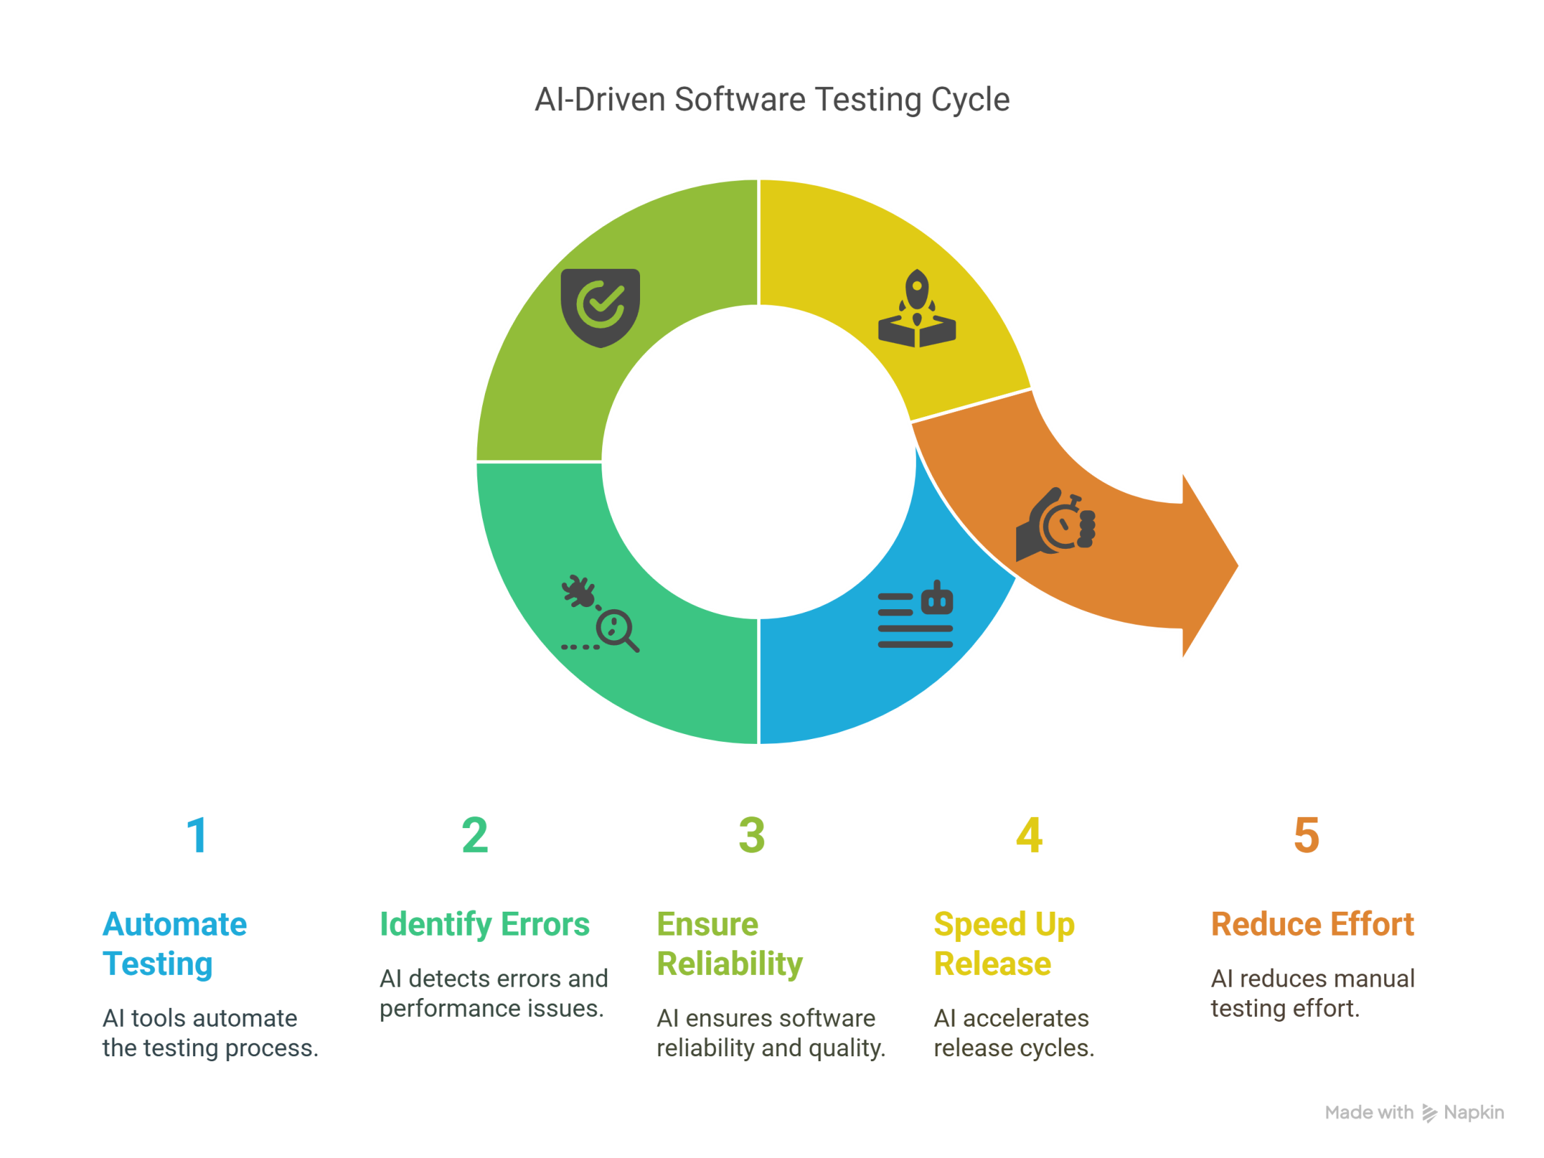
Slide Title
Testing Tools
https://www.testim.io/
Testim: It utilizes AI to author, execute, and maintain tests, speeding up the release cycles and reducing the effort required in testing.
Notes:
Testing tools
AI-assisted testing tools automate the process of testing the code. They use AI to perform rigorous tests, identifying errors and performance issues that might not be apparent during development. By automating the testing process, they ensure the reliability and quality of the software.
Testim: It utilizes AI to author, execute, and maintain tests, speeding up the release cycles and reducing the effort required in testing.

Slide 17
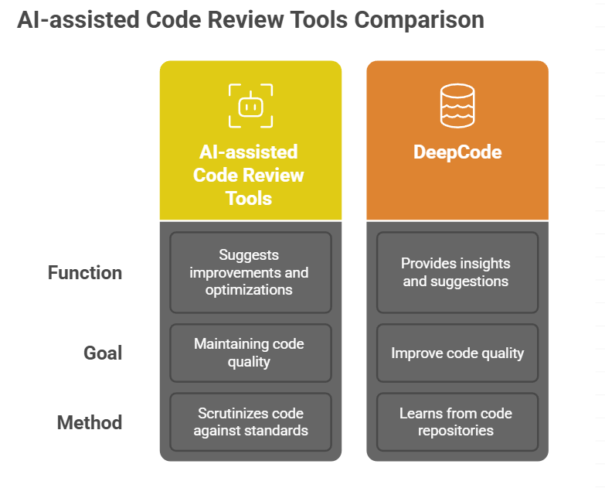
Slide Title
Code Review Tools
Notes:
Code review tools
AI-assisted code review tools scrutinize the code against predefined standards and best practices, suggesting improvements and optimizations. They assist in maintaining code quality and adherence to coding standards, ensuring the developed software is of high quality.
DeepCode: It reviews the code and learns from millions of code repositories, providing insights and suggestions to improve code quality by leveraging AI and semantic code analysis.

Slide 18
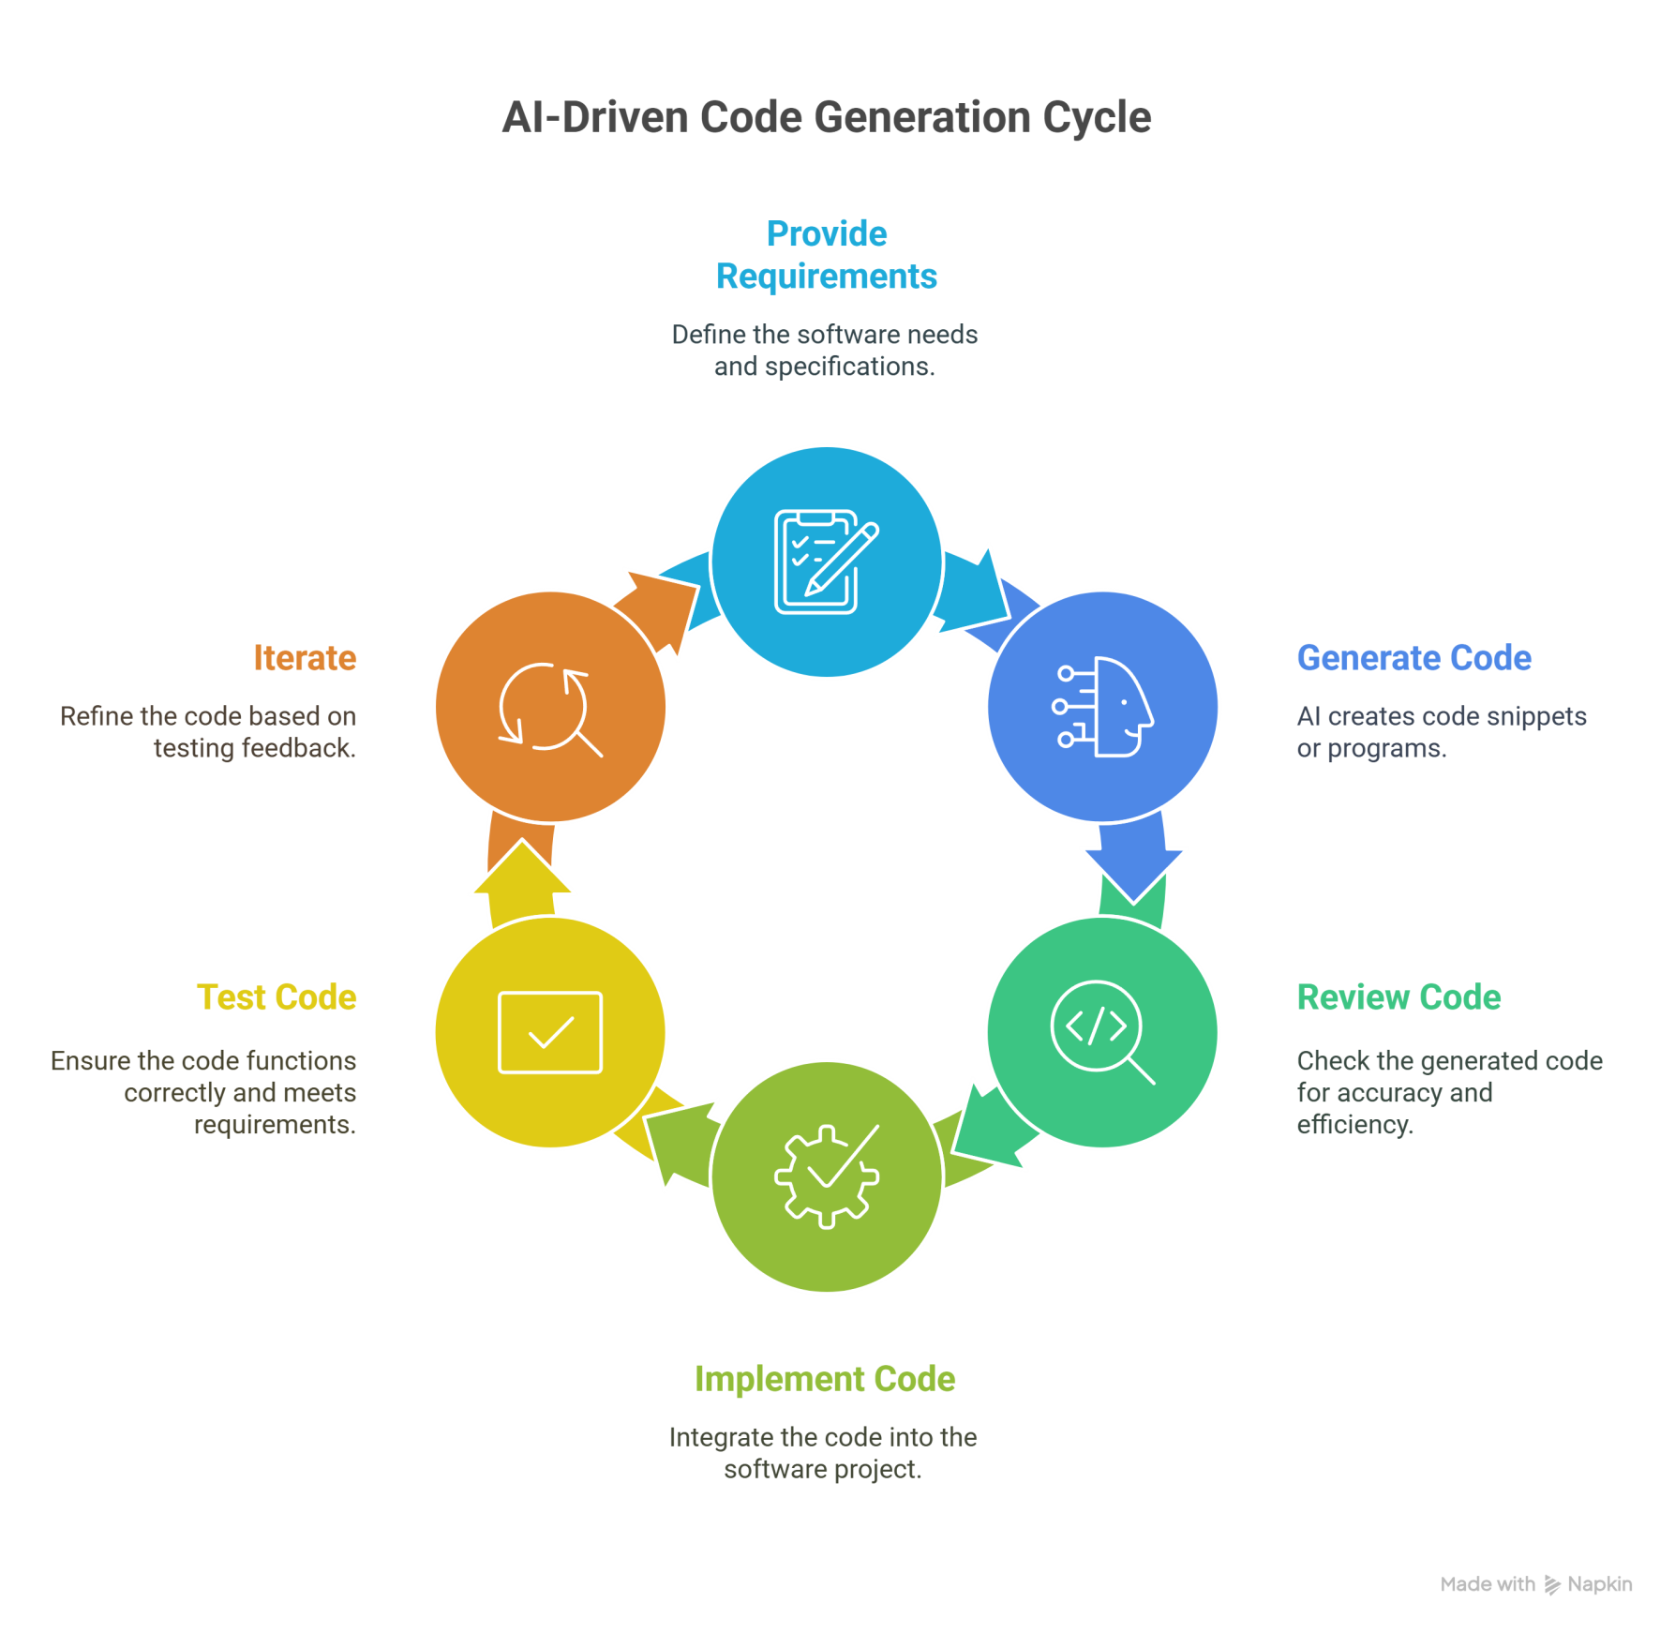
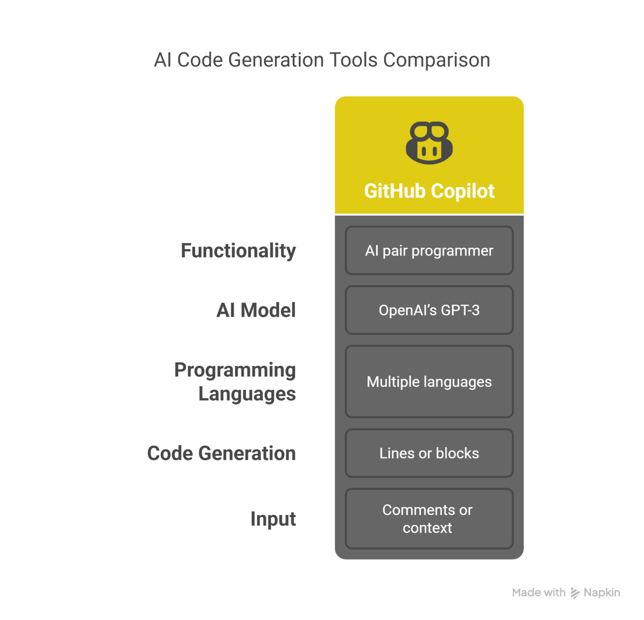
Slide Title
Code Generation Tools
Notes:
These tools employ AI to automatically generate code snippets or entire programs based on the provided requirements or designs. They aid in rapidly translating ideas into functional code, accelerating the software development process.
GitHub Copilot: It is an AI pair programmer powered by OpenAI’s GPT-3 that helps write new code and works in multiple programming languages, generating entire lines or blocks of code based on the comments or context.

Slide 19
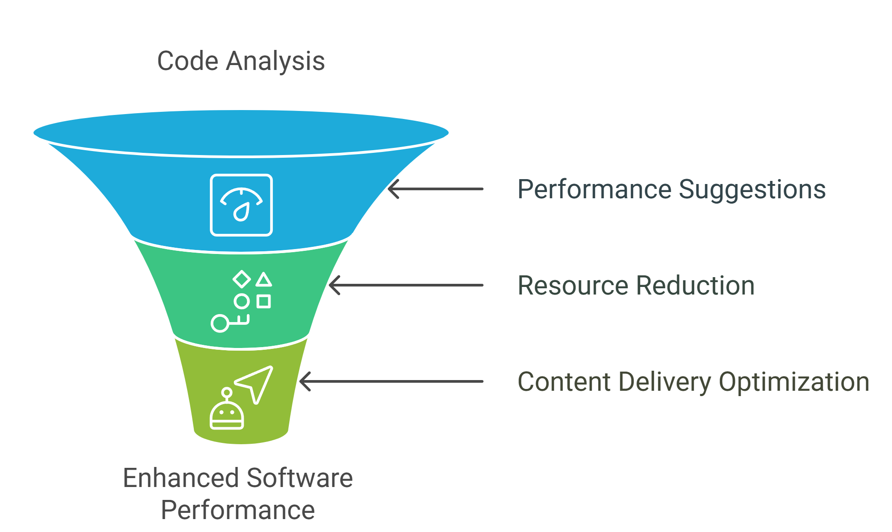

Slide Title
Optimization tools
Varnish Software: It uses AI to optimize content delivery, improving the speed and performance of web applications.
https://www.varnish-software.com/
Notes:
Optimization tools
AI-powered optimization tools analyze the code to suggest performance improvements and optimizations. They help refine the code to run more efficiently and consume fewer resources, ensuring the developed software is optimized for performance.
Varnish Software: It uses AI to optimize content delivery, improving the speed and performance of web applications.
Each AI-assisted coding tool plays a pivotal role in different stages of the software development lifecycle, contributing to enhanced productivity, quality, security, and reliability of the software products.

Slide 20
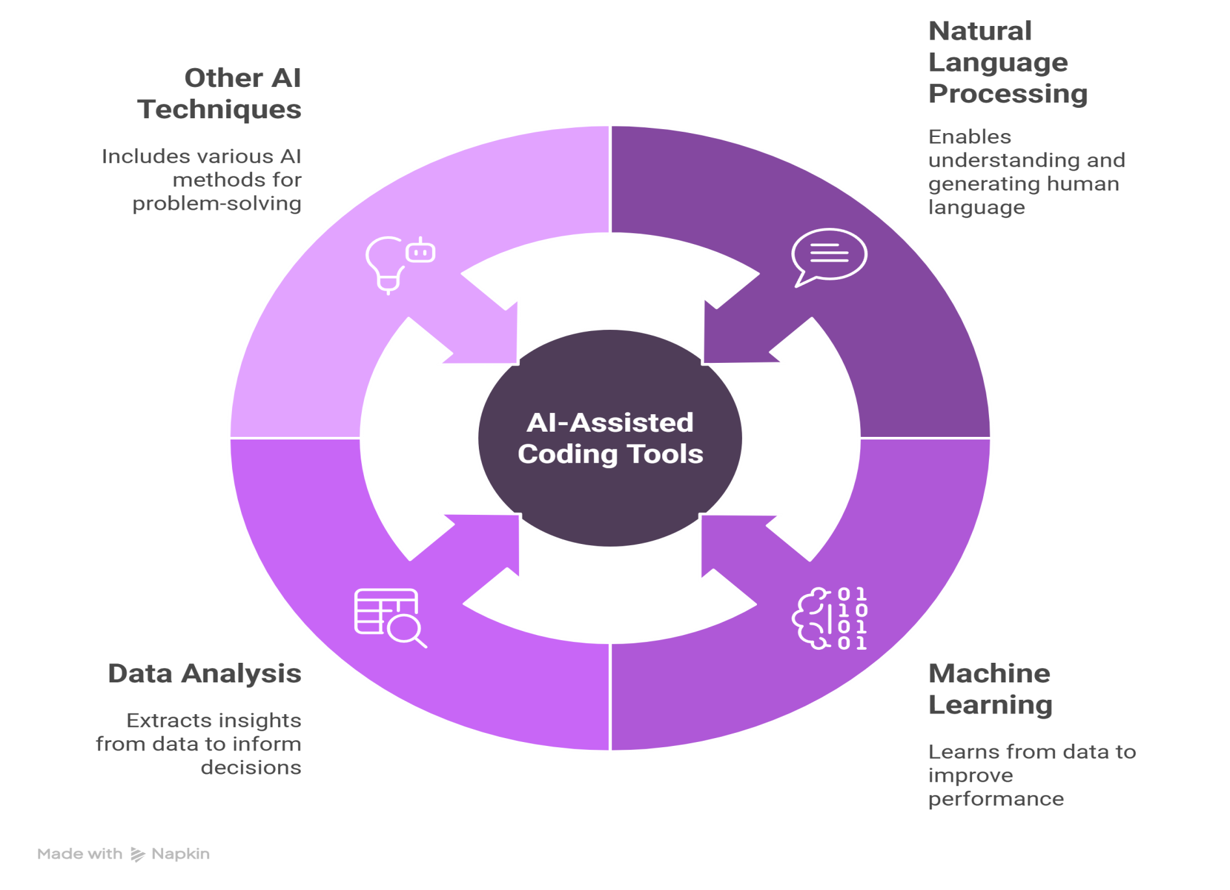
Slide Title
The working mechanism of an AI-assisted coding tool
AI-assisted coding tools stand at the convergence of
Natural Language Processing (NLP), Machine Learning (ML), data analysis, and other AI techniques.
Notes:
AI-assisted coding tools stand at the convergence of advanced technologies, seamlessly integrating Natural Language Processing (NLP), Machine Learning (ML), data analysis, and other AI techniques to transform the software development process.

Slide 21
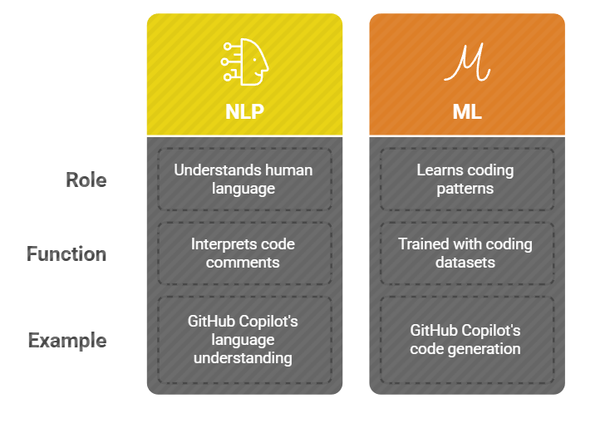
Slide Title
Natural Language Processing (NLP) and Machine Learning (ML)
Notes:
NLP and ML form the backbone of AI-assisted coding tools. NLP empowers these tools to understand and interpret human languages in the code, like comments and variable names, allowing for better context comprehension and, thus, more accurate suggestions. ML algorithms, trained with extensive datasets comprising diverse coding patterns and structures, enable the tools to learn and adapt to different coding styles and preferences, ensuring continuous improvement and customization.
Example: GitHub Copilot utilizes advanced NLP and ML models trained on millions of public code repositories, allowing it to understand coding contexts and generate relevant code suggestions.

Slide 22
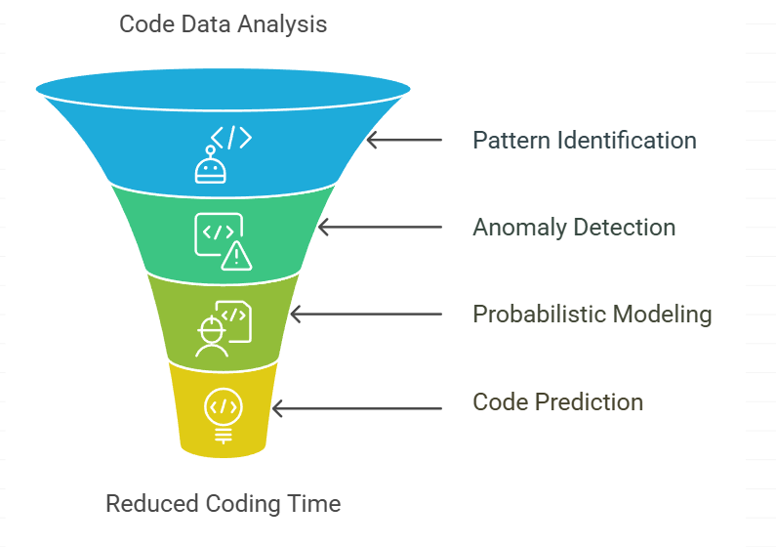
Slide Title
Data analysis in code prediction
Data analysis is integral to the functioning of AI-assisted coding tools. These tools can identify patterns, trends, and anomalies by analyzing vast amounts of code data, facilitating accurate code prediction
Notes:
Data analysis is integral to the functioning of AI-assisted coding tools. These tools can identify patterns, trends, and anomalies by analyzing vast amounts of code data, facilitating accurate code prediction. They use probabilistic models and statistical analysis to predict the most likely next line or block of code based on the analyzed data, significantly reducing the coding time and minimizing errors.
Example: Kite employs data analysis to offer intelligent code completions, using the analyzed patterns to predict and suggest relevant code snippets in real-time.

Slide 23
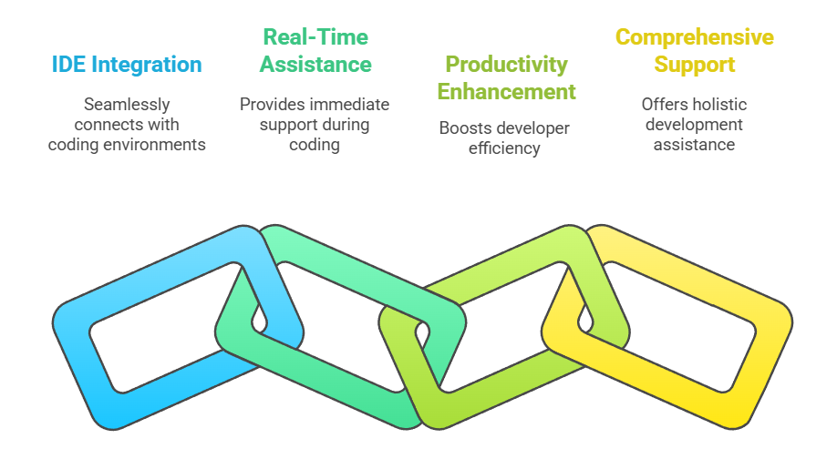


Slide Title
Integration with Integrated Development Environments (IDEs)
Notes:
AI-assisted coding tools are designed to seamlessly integrate with various IDEs, providing developers with real-time assistance as they write code. This integration enables developers to access the tool’s features and capabilities directly within their preferred coding environment, enhancing their productivity and coding experience. The integration also ensures that the tools can work in sync with other development tools and processes, offering comprehensive support to developers.
Example: DeepCode offers plugins for popular IDEs like Visual Studio Code and IntelliJ IDEA, allowing developers to receive real-time code reviews and suggestions directly in their development environment.

Slide 24
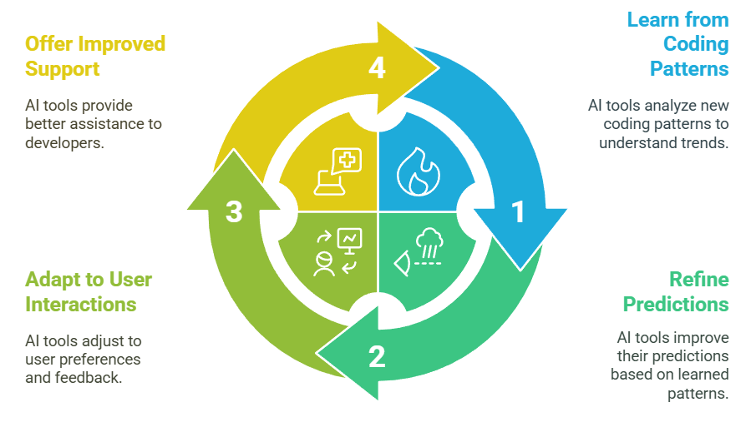
Slide Title
Continuous learning and adaptation
These tools are not just augmenting the coding experience but are also learning and evolving with every interaction, promising a future where the synergy between human intellect and artificial intelligence can push the boundaries of software development.
Notes:
A distinctive feature of AI-assisted coding tools is their ability to learn and adapt continuously. Developers of these tools learn from the new coding patterns and user interactions, refining their predictions and suggestions. This continuous learning ensures that the tools stay updated with the latest coding trends and developer preferences, offering ever-improving support to developers.
Example: Rookout utilizes continuous learning to adapt its debugging suggestions and insights based on the evolving codebase and developer interactions.

Slide 25
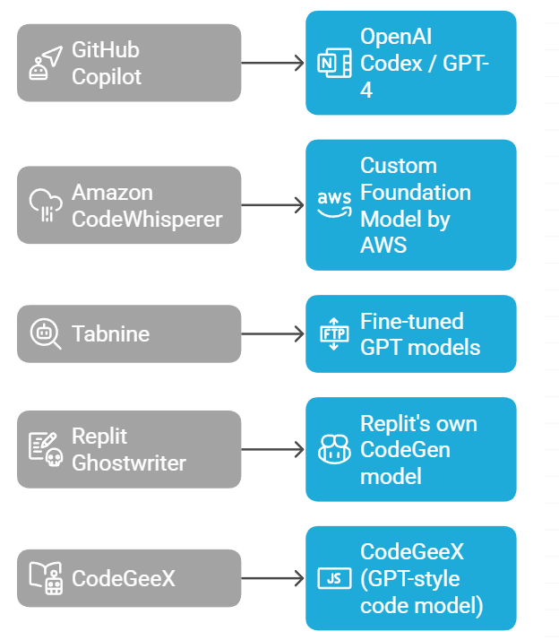
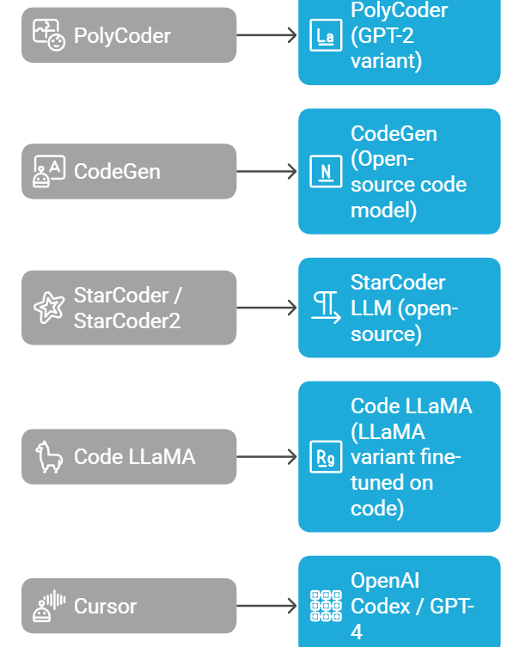
Slide Title
AI-assisted coding tools + Generative AI models
Notes:
Tool Name Backed By / Company Generative AI Model GitHub Copilot GitHub + OpenAI OpenAI Codex / GPT-4 Amazon CodeWhisperer Amazon Web Services (AWS) Custom Foundation Model by AWS Tabnine Tabnine (formerly Codota) Fine-tuned GPT models (custom) Kite (discontinued) Kite Proprietary ML models (Python-based) Replit Ghostwriter Replit Replit's own CodeGen model CodeGeeX Tsinghua University & BAAI CodeGeeX (GPT-style code model) PolyCoder Carnegie Mellon University PolyCoder (GPT-2 variant) CodeGen Salesforce Research CodeGen (Open-source code model) StarCoder / StarCoder2 Hugging Face + ServiceNow Labs StarCoder LLM (open-source) Code LLaMA Meta Code LLaMA (LLaMA variant fine-tuned on code) Cursor Cursor Uses OpenAI Codex / GPT-4

Slide 26
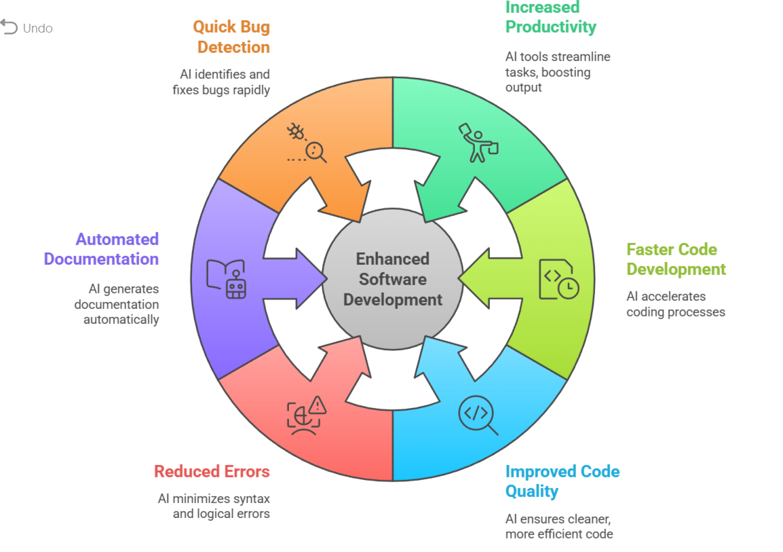
Slide Title
Benefits of AI-assisted coding
Notes:
Increased Productivity in AI-assisted coding means that developers can complete tasks more quickly and efficiently by leveraging AI tools. This includes:
Faster code writing through intelligent autocompletion
Reduced time spent on debugging and error fixing
Quick generation of repetitive or boilerplate code
Automated documentation and testing
Fewer context switches (less need to search for syntax or examples)
Improved focus on logic and design instead of syntax
Faster Code Development
Improved Code Quality
Reduced Syntax and Logical Errors
Automated Code Documentation
Quick Bug Detection and Fixing

Slide 27
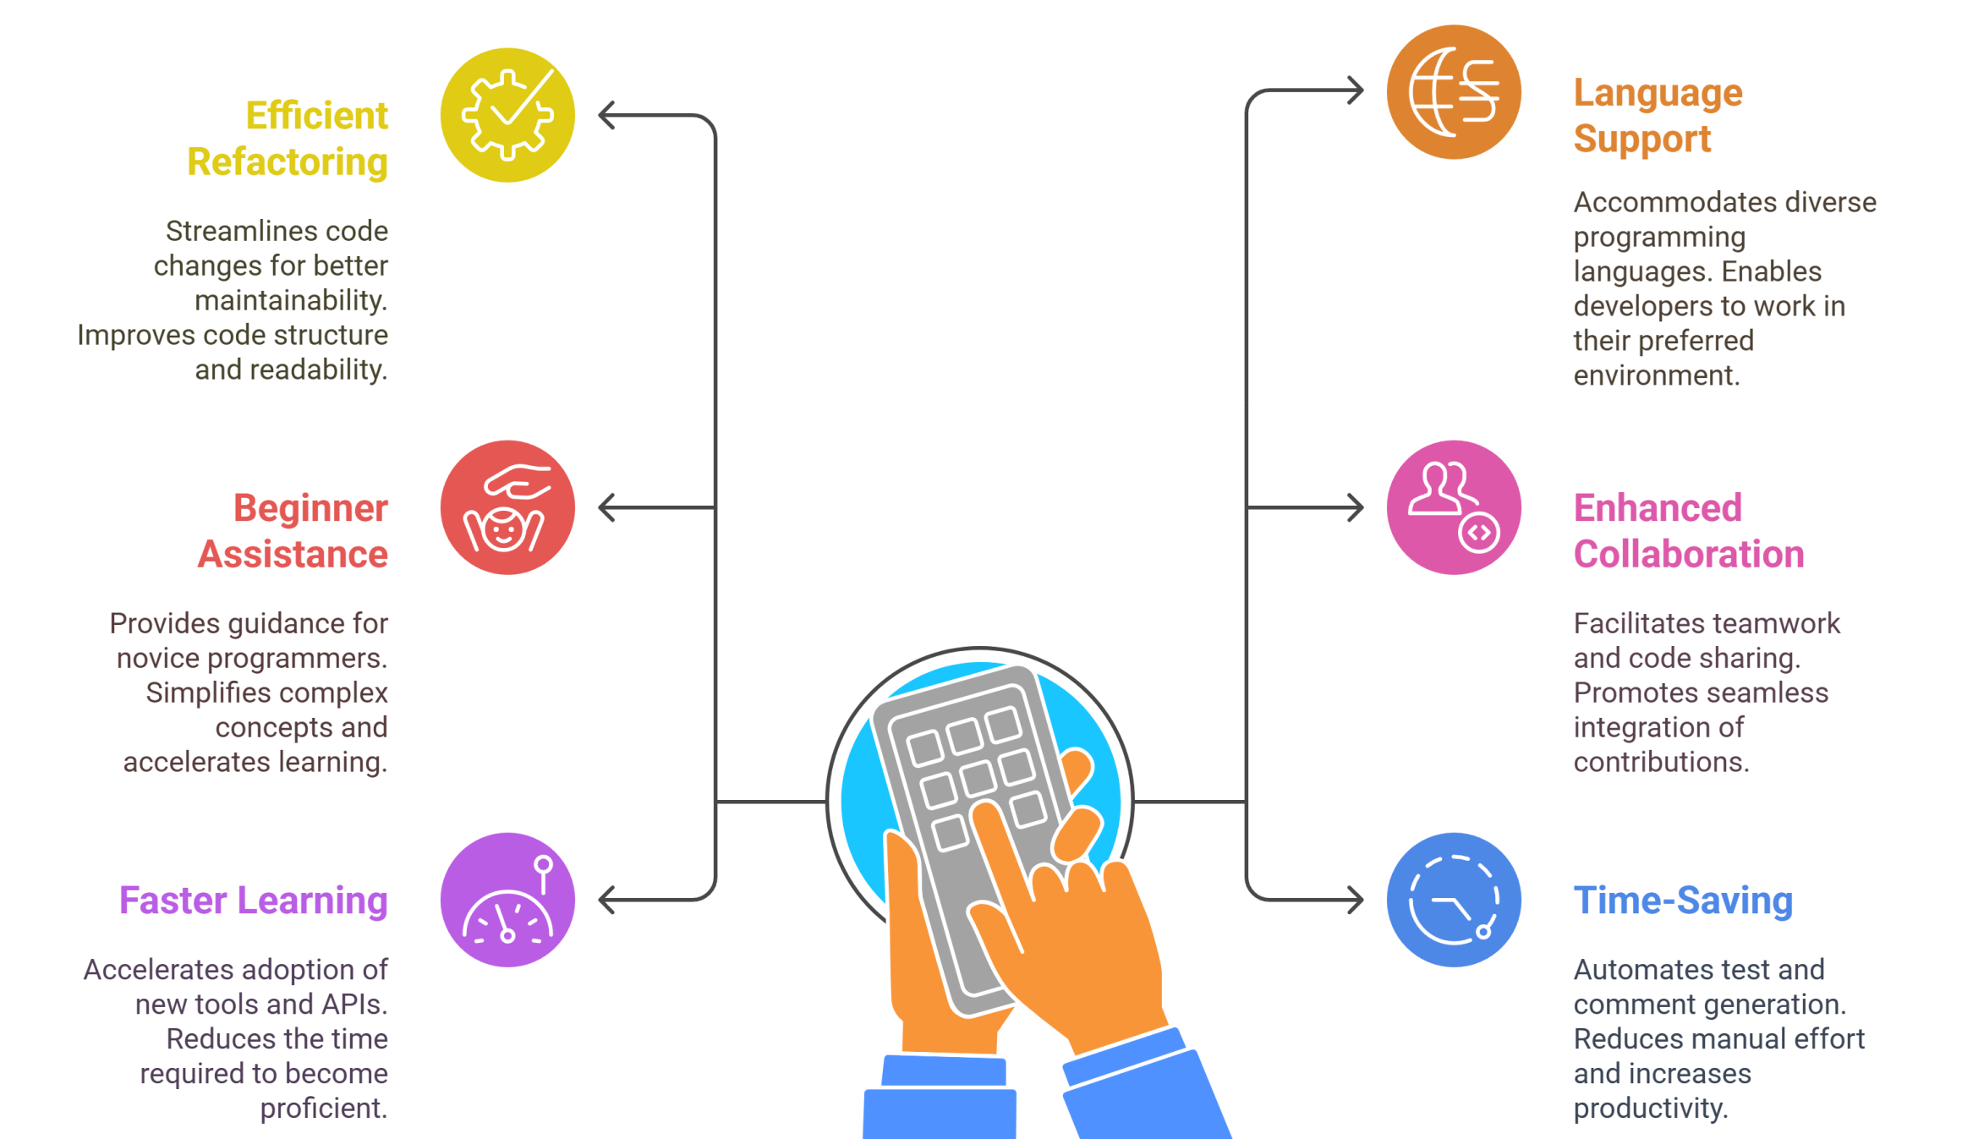
Slide Title
Benefits of AI-assisted coding
Notes:
Efficient Code Refactoring: Efficient Code Refactoring means improving the structure, readability, and maintainability of existing code without changing its functionality, using AI tools to:
Automatically clean up messy or duplicated code
Rename variables/functions for better clarity
Simplify complex logic or nested conditions
Reorganize code into modular and reusable parts
Follow consistent coding styles and best practices
Support for Multiple Programming Languages: C, C#, Python , Java etc
Assistance for Beginners and Non-Experts in AI-assisted coding refers to how AI tools help those with limited programming experience by:
Providing real-time code suggestions
Translating natural language instructions into code
Generating sample code snippets
Auto-completing syntax and functions
Offering explanations for complex code
Suggesting best practices and common patterns
Helping debug errors with clear suggestions
Enhanced Collaboration and Code Sharing in AI-assisted coding refers to how AI tools help teams work together more effectively by:
Generating consistent and readable code that’s easier for others to understand
Auto-documenting code, making it clearer for collaborators
Summarizing code changes for quick reviews and team discussions
Suggesting standardized coding practices, reducing style conflicts
Integrating with version control systems like Git for smoother code sharing
Improving pull request quality through AI-driven code reviews and feedback
Faster Learning Curve for New Tools or APIs in AI-assisted coding means that AI helps developers quickly understand and use unfamiliar technologies by:
Suggesting correct API methods and usage patterns
Providing code examples in real time
Auto-completing function names and parameters
Offering inline documentation or explanations
Reducing the need to constantly search through external documentation
Identifying common mistakes and offering corrections
Time-Saving in Writing Tests through AI-assisted coding refers to how AI tools help automate the creation of test cases, reducing manual effort and speeding up the testing process. This includes:
Auto-generating unit tests for functions and classes
Suggesting test inputs and expected outputs
Detecting edge cases that need testing
Creating test templates based on code structure
Improving test coverage without writing every test manually
Helping maintain test consistency across the codebase

Slide 28
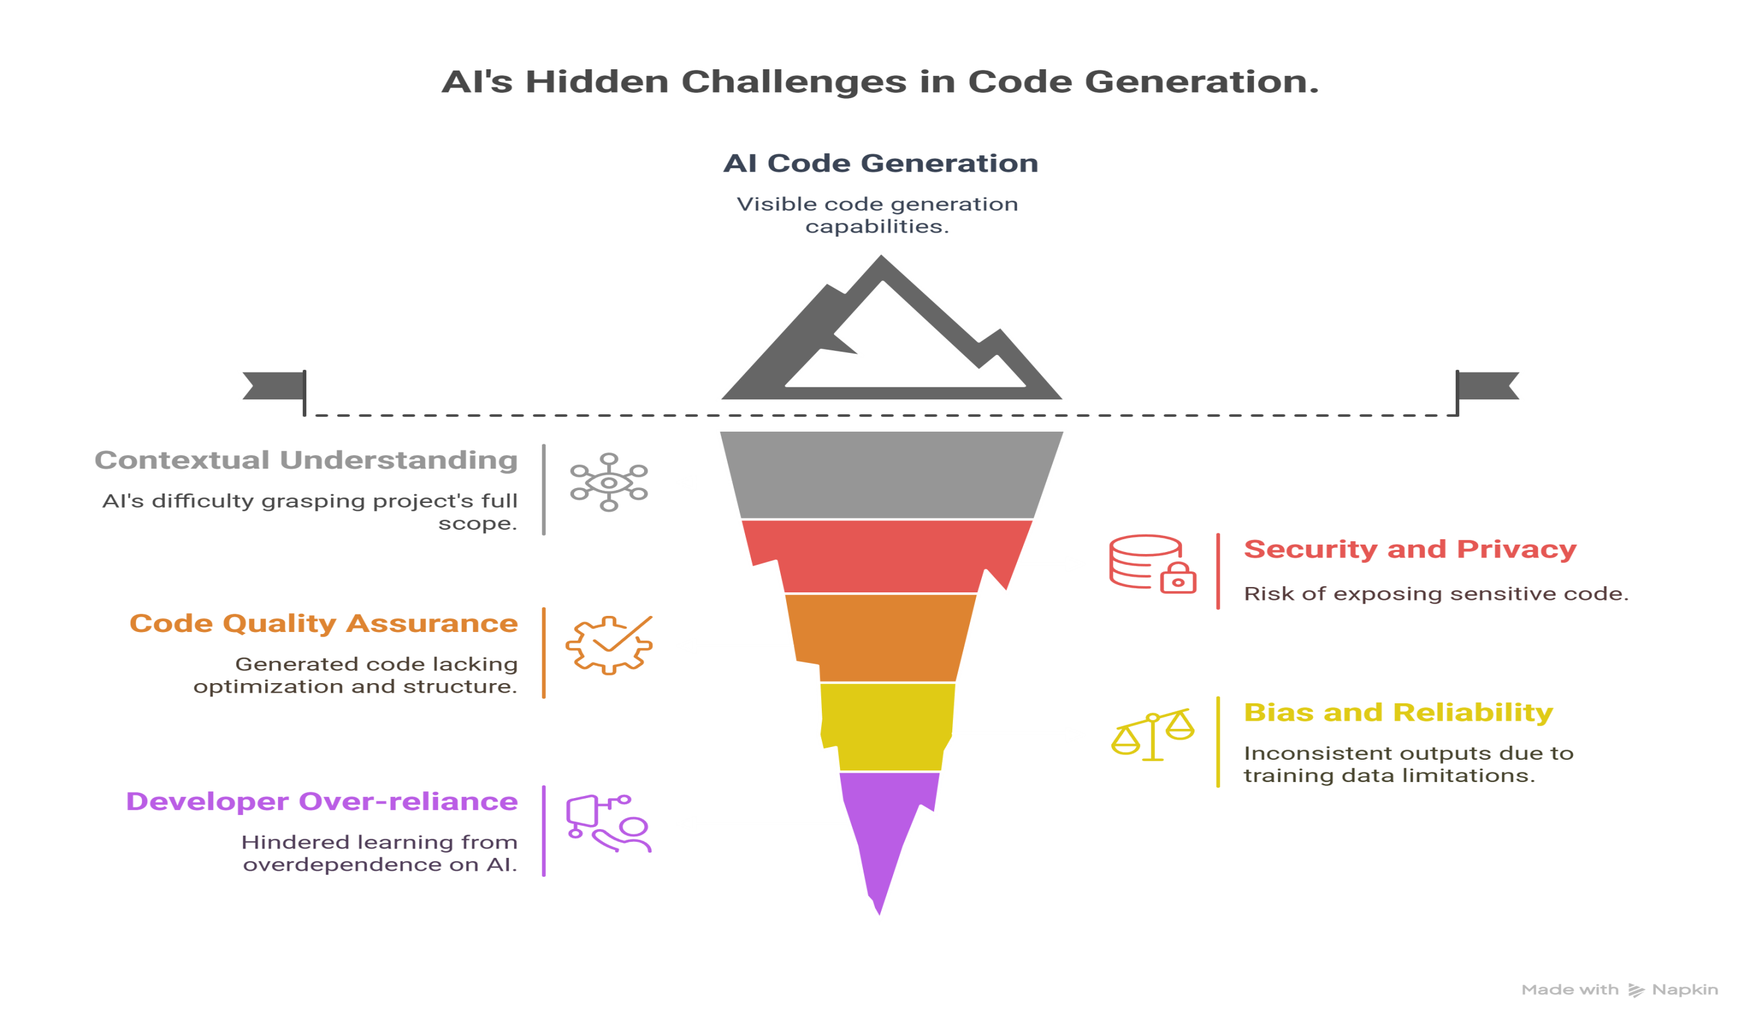
Slide Title
Challenges in AI-Assisted Coding
Notes:
Context Understanding: AI often struggles with understanding the full context of a large project or legacy codebase.
Security and Privacy: AI tools may unintentionally expose proprietary or sensitive code, especially when using cloud-based models.
Code Quality Assurance: Generated code may compile but lack optimization, readability, or proper structure.
Bias and Reliability: AI models may produce biased or inconsistent outputs due to limitations in training data.
Developer Over-reliance: Overdependence on AI tools can hinder learning and deep understanding of programming concepts.

Slide 29
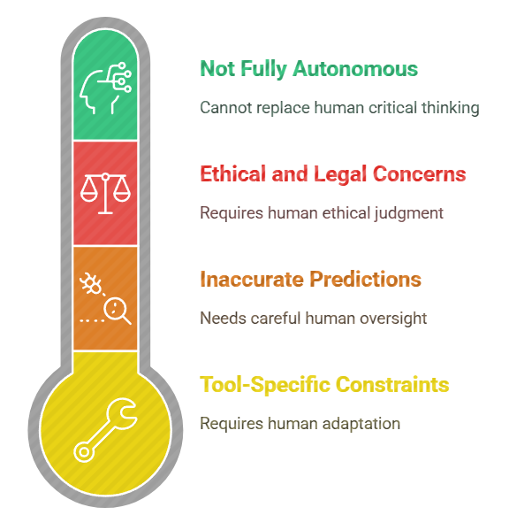
Slide Title
Limitations in AI-Assisted Coding
Notes:
Not Fully Autonomous: AI can assist but not replace human logic, architectural decisions, or critical thinking in problem-solving.
Tool-Specific Constraints: Some tools are limited to specific languages, platforms, or IDEs.
Inaccurate Predictions: AI-generated code snippets might not always align with project-specific requirements.
Ethical and Legal Concerns: Issues around code licensing, plagiarism, and use of open-source code remain unresolved.

Slide 30
Slide Title
References
https://www.leewayhertz.com/ai-assisted-coding/#Benefits-of-AI-assisted-coding
https://www.transmedia.co.uk/article/what-is-ai-assisted-coding
https://docs.github.com/en/copilot
Thank You
Notes:
Not Fully Autonomous: AI can assist but not replace human logic, architectural decisions, or critical thinking in problem-solving.
Tool-Specific Constraints: Some tools are limited to specific languages, platforms, or IDEs.
Inaccurate Predictions: AI-generated code snippets might not always align with project-specific requirements.
Ethical and Legal Concerns: Issues around code licensing, plagiarism, and use of open-source code remain unresolved.

